Slide 1
Starbucks
Growth forecast
5MA Symmetrical technique

Slide 2
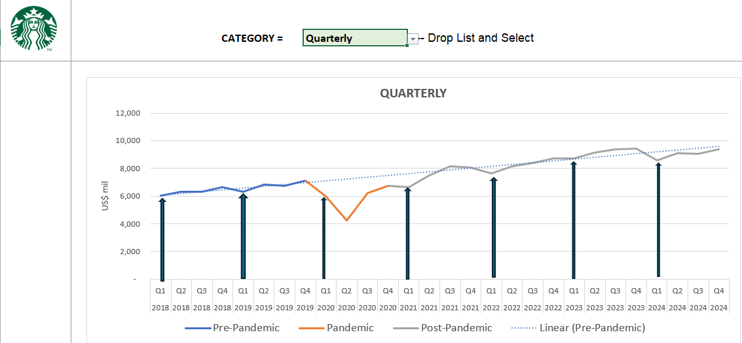
Time Series: Analysis of Quarterly sales revenue
Year | Q1 Revenue (millions) | Remarks
2018 | 6000 | Pre-pandemic
2019 | 6306 | Pre-pandemic
2020 | 5996 | Pandemic
2021 | 6668 | Post-pandemic
2022 | 7636 | Post-pandemic
2023 | 8720 | Post-pandemic
2024 | 8563 | Post-pandemic

Slide 3
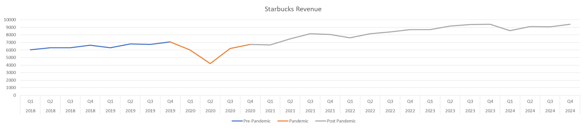
Overall Quarterly Trend
Starbucks saw a sharp COVID-led contraction in 2020, a strong rebound through 2021–2022, and stabilisation post-2023.
Pre-Pandemic
Pandemic
Post-Pandemic
Steady revenue growth
Strong digital engagement
Significant international expansion
Revenue fell with sharp declines
Temporary shift in consumer habits
Closures across all major markets
Rebound led by North America
Revenue stabilised around $36B
Growth plateaued
Source: Starbucks Annual Reports 2019–2024
Notes:
●Pre-Pandemic: Starbucks grew steadily from $24.7B in FY2018 to $26.5B in FY2019, supported by digital tools and store growth.
●Pandemic: FY2020 dropped to $23.5B due to global closures and reduced mobility. Q2 and Q3 were the worst hit.
●Post-Pandemic: FY2021 rebounded to $29.1B; FY2023–24 stabilised near $36B. Margins tightened due to labour and inflation costs.
Pre-Pandemic Starbucks revenue grew from $24.7B in FY2018 to $26.5B in FY2019 (CAGR ~3.5%), driven by same-store sales growth and new store openings. Strong digital engagement, with expanding use of Starbucks Rewards and Mobile Order & Pay, especially in the U.S. Significant international expansion, especially in China, which contributed $3.0B in revenue in 2019.
Pandemic: Global revenue declined to $23.5B in FY2020, a ~11% YoY decline due to temporary store closures, reduced hours, and lower footfall. Temporary shift in consumer habits; reduced urban and commuter foot traffic Starbucks closed stores temporarily across all major markets . U.S. comparable store sales fell 12%, while international markets faced even greater disruption, notably China.
Post-Pandemic: FY2021 revenue rebounded to $29.1B, up 24% YoY, driven by reopening and increased digital ordering FY2023 and FY2024 revenues stabilised at $35.98B and $36.18B respectively. However, inflation, higher wages, and reduced transaction volumes began compressing operating margins

Slide 4
Act 2 – Forecasting- 5MA Symmetrical
•5MA symmetrical technique is used for initial forecast.
•All three segment forecast charts are plotted and included for post-pandemic period
oLOB – Beverages, Food, Other(LOB)
oMARKET – North- America, International, Other(MARKET)
oSTORE TYPE – Company-Op, Licensed, Other(Store)
•YoY% growth change is calculated for each listed item in the segments.
•Observations and recommendations are included.

Slide 5
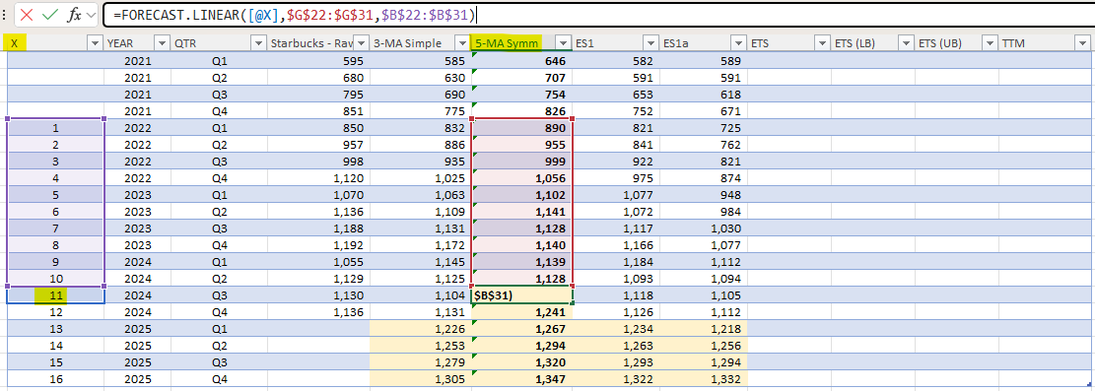
5-Month moving average symmetrical technique
Excel Formula
=FORECAST.LINEAR(forecast period(X), G2:G10, B2:B10)
Example
11 → The next time period (Nov)
G2:G10 → Known sales values (dependent variable)
B2:B10 → Month numbers (Jan to Oct)

Slide 6
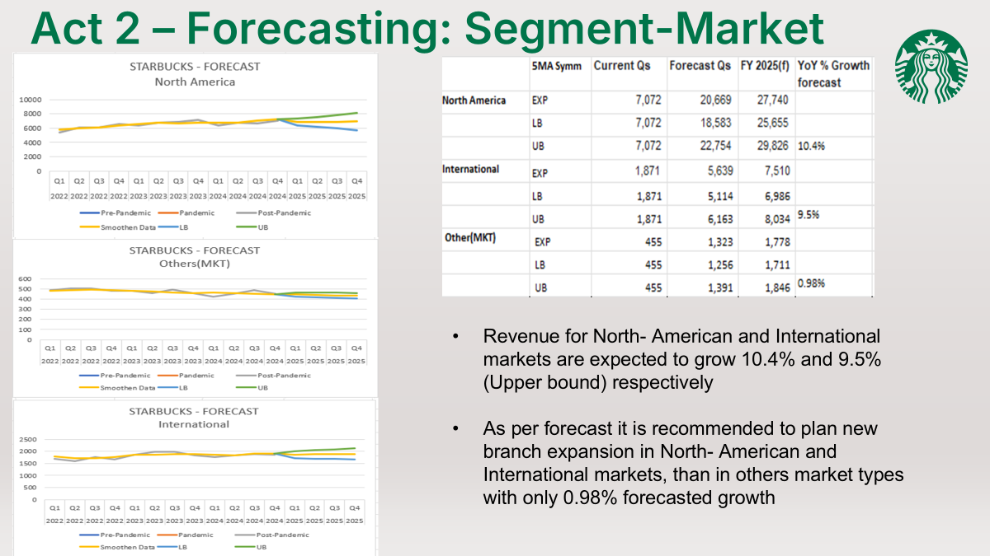

Slide 7
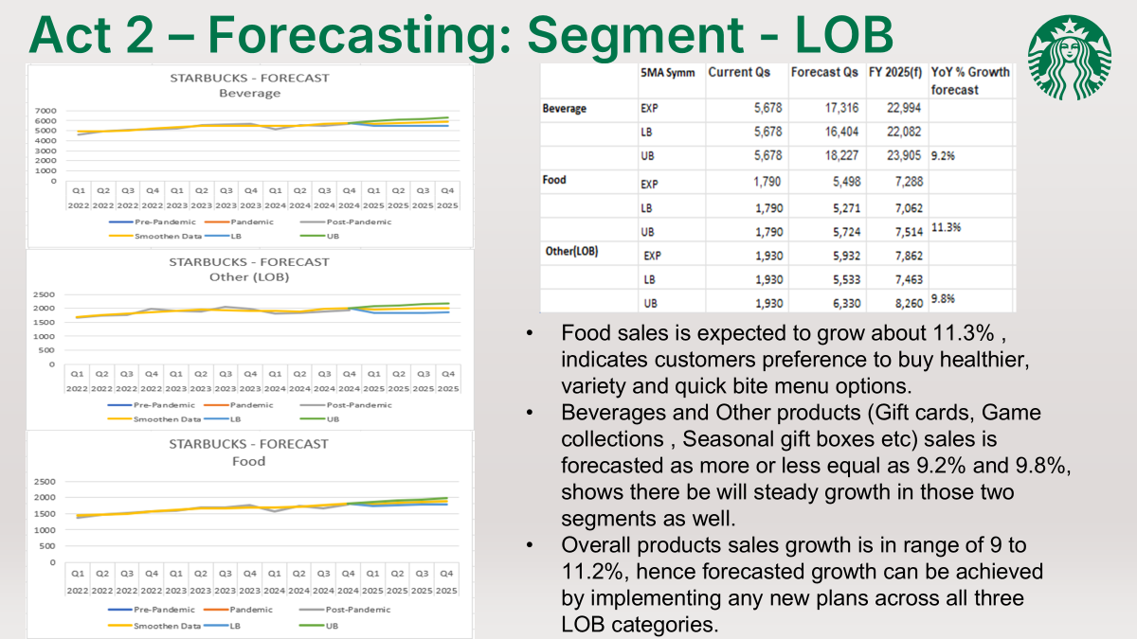

Slide 8
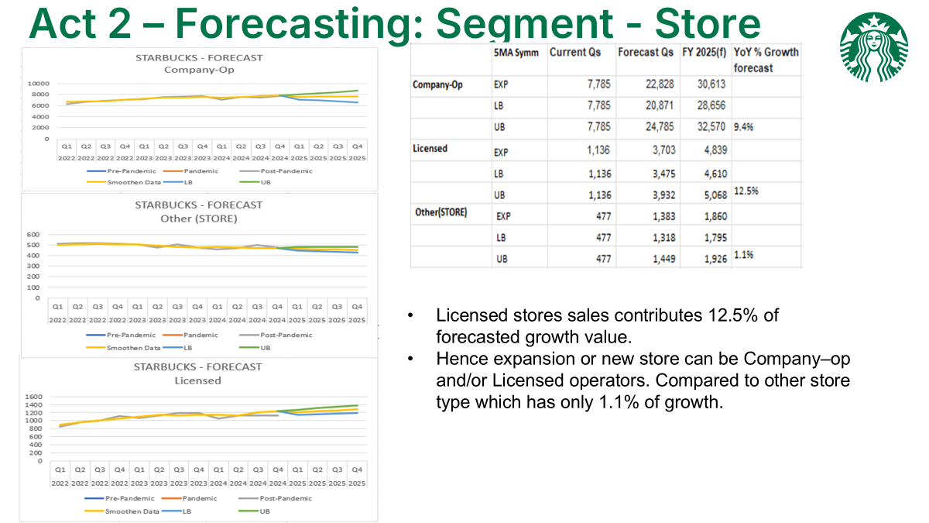

Slide 9
Conclusion
Forecast Highlights: Revenue may remain flat in the near term under expected scenarios due to tariff-related cost increases and labor challenges. Strategic efforts like “Back to Starbucks” and digital enhancements help
stabilize the outlook.
Strategic Priorities:
Balance U.S. market saturation with high-growth opportunities in Asia-Pacific.

Slide 10
THANK YOU

